Slide 1
Part IV Review

Slide 2
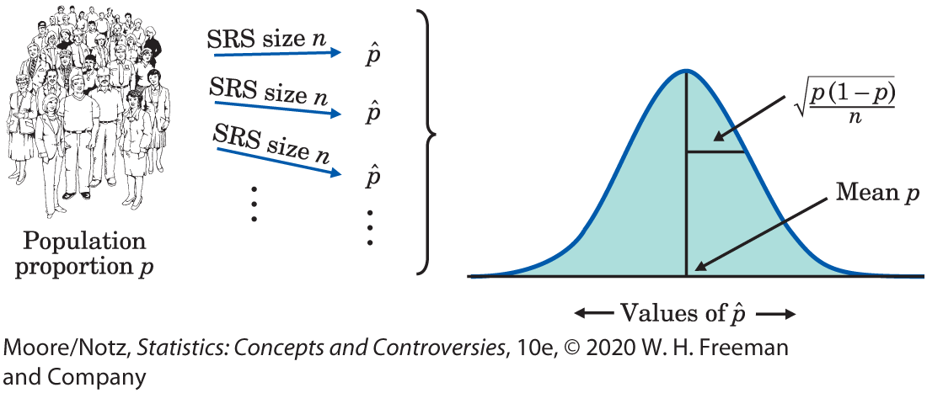
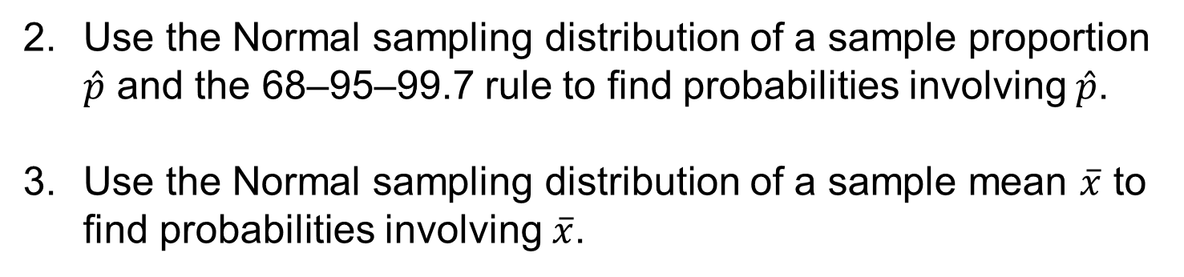
A. SAMPLING DISTRIBUTIONS
Explain the idea of a sampling distribution.
Use the Normal sampling distribution of a sample proportion $\hat{p}$ and the 68–95–99.7 rule to find probabilities involving $\hat{p}$.
Use the Normal sampling distribution of a sample mean $\overline{x}$ to find probabilities involving $\overline{x}$.

Slide 3
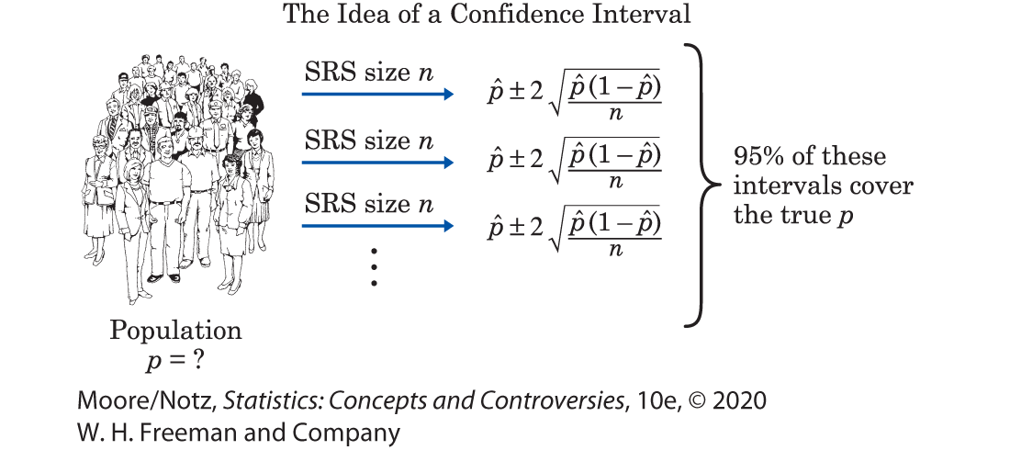
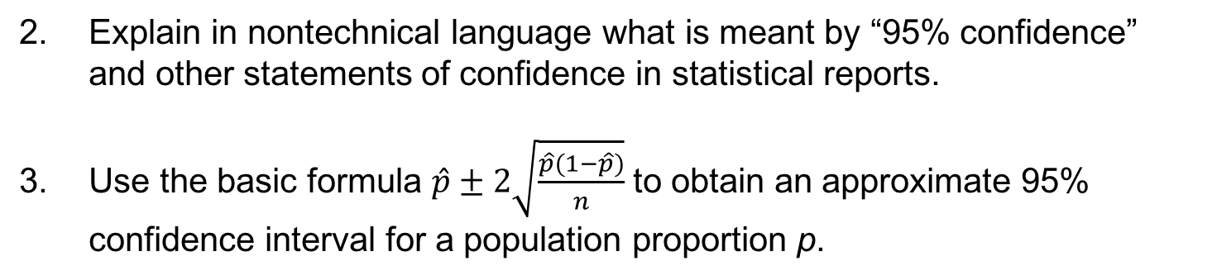
B. CONFIDENCE INTERVALS 1
Explain the idea of a confidence interval.
Explain in nontechnical language what is meant by “95% confidence” and other statements of confidence in statistical reports.
Use the basic formula $\hat{p}±2\sqrt{\frac{\hat{p}(1−\hat{p})}{n}}$ to obtain an approximate 95% confidence interval for a population proportion p.

Slide 4
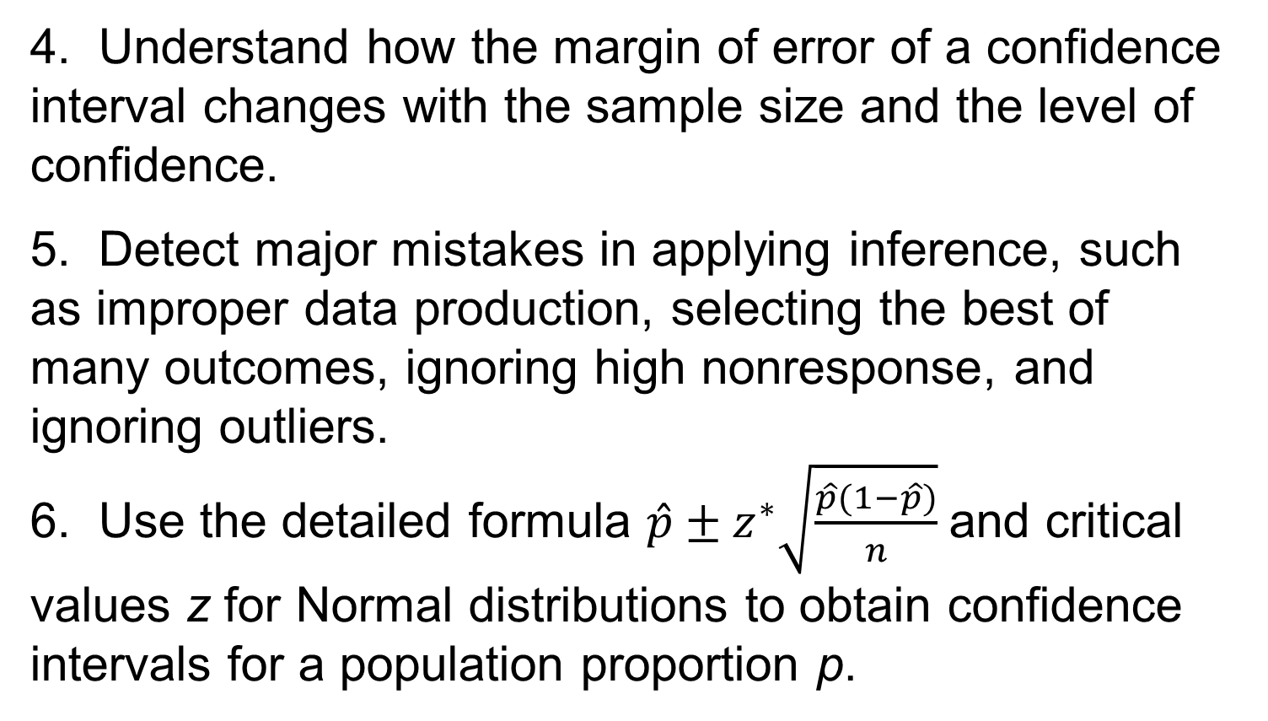
B. CONFIDENCE INTERVALS 2
4. Understand how the margin of error of a confidence interval changes with the sample size and the level of confidence.
5. Detect major mistakes in applying inference, such as improper data production, selecting the best of many outcomes, ignoring high nonresponse, and ignoring outliers.
6. Use the detailed formula $\hat{p}±z^{∗}\sqrt{\frac{\hat{p}(1−\hat{p})}{n}}$and critical values z for Normal distributions to obtain confidence intervals for a population proportion p.

Slide 5
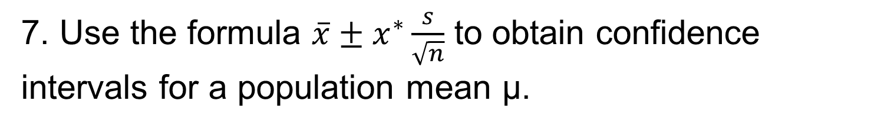
B. CONFIDENCE INTERVALS 3
7. Use the formula $\overline{x}±x^{∗}\frac{s}{\sqrt{n}}$ to obtain confidence intervals for a population mean µ.

Slide 6
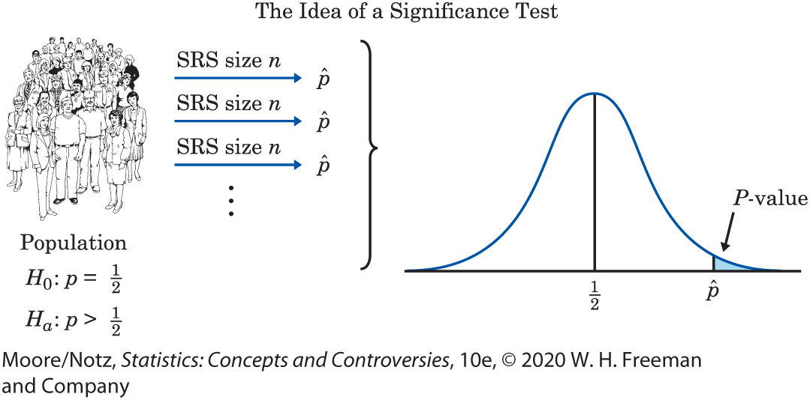
C. SIGNIFICANCE TESTS 1
Explain the idea of a significance test.
2. State the null and alternative hypotheses in a testing situation when the parameter in question is a population proportion p.
3. Explain in nontechnical language the meaning of the P-value when you are given its numerical value for a test.

Slide 7
C. SIGNIFICANCE TESTS 2
4. Explain the meaning of “statistically significant at the 5% level” and other statements of significance. Explain why significance at a specific level such as 5% is less informative than a P-value.
5. Recognize that significance testing does not measure the size or importance of an effect.
6. Recognize and explain the effect of small and large samples on the statistical significance of an outcome.

Slide 8
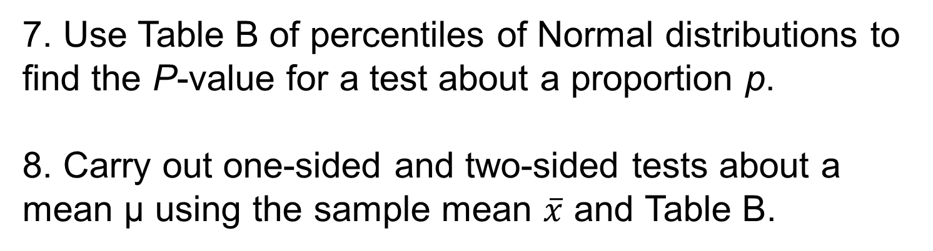
C. SIGNIFICANCE TESTS 3
7. Use Table B of percentiles of Normal distributions to find the P-value for a test about a proportion p.
8. Carry out one-sided and two-sided tests about a mean µ using the sample mean $\overline{x}$ and Table B.

Slide 9
D. TWO-WAY TABLES 1
1. Create two-way tables for data classified by two categorical variables.
2. Use percents to describe the relationship between any two categorical variables based on the counts in a two-way table.
3. Explain what null hypothesis the chi-square statistic tests in a specific two-way table.

Slide 10
D. TWO-WAY TABLES 2
4. Calculate expected cell counts, the chi-square statistic, and its degrees of freedom from a two-way table.
Use Table 24.1 (see following slide) for chi-square distributions to assess significance. Interpret the test result in the setting of a specific two-way table.

Slide 11
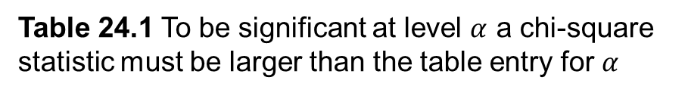
D. TWO-WAY TABLES 3
Table 24.1 To be significant at level $α$ a chi-square statistic must be larger than the table entry for $α$
Signficance Level $α$
df | 0.25 | 0.20 | 0.15 | 0.10 | 0.05 | 0.01 | 0.001
1 | 1.32 | 1.64 | 2.07 | 2.71 | 3.84 | 6.63 | 10.83
2 | 2.77 | 3.22 | 3.79 | 4.61 | 5.99 | 9.21 | 13.82
3 | 4.11 | 4.64 | 5.32 | 6.25 | 7.81 | 11.34 | 16.27
4 | 5.39 | 5.99 | 6.74 | 7.78 | 9.49 | 13.28 | 18.47
5 | 6.63 | 7.29 | 8.12 | 9.24 | 11.07 | 15.09 | 20.51
6 | 7.84 | 8.56 | 9.45 | 10.64 | 12.59 | 16.81 | 22.46
7 | 9.04 | 9.80 | 10.75 | 12.02 | 14.07 | 18.48 | 24.32
8 | 10.22 | 11.03 | 12.03 | 13.36 | 15.51 | 20.09 | 26.12
9 | 11.39 | 12.24 | 13.29 | 14.68 | 16.92 | 21.67 | 27.88

